Slide 1
GOOD DOCUMENTATION PRACTICE

Slide 2



Good Documentation Practice
Definition:
Core Standards:
Impact:
A systematic procedure of preparing, reviewing, approving, issuing, recording, storing, and archiving of documents.
GDP describes the standards by which documents are created and maintained.
Ensures reliable, consistent transmission of data, ensures product quality and safety, and complies with regulatory expectations.

Slide 3





Why are document standards important?
To visualise the series of event during manufacturing of Drug/Finished Goods
Recording
Review
Issues
Storing
Archiving

Slide 4



Why are document standards important?
Event Visualization:
Compliance:
Evidence:
Gives information on when, where, who, why, and how to complete tasks. Serves as evidence proving that tasks have been completed as they should be.
To visualize the series of events during the manufacturing of drugs and finished goods.
Regulations from PIC/S, FDA, and EU all include mandatory sections on documentation.

Slide 5






Basics of GDP
All documentation follows GDP. Key questions to be considered each time when you record your data:
Is it attributable?
Is it contemporaneous?
Is it accurate?
Is it permanent?
Is it legible?
Is it original?
Is it complete?

Slide 6



Basics of GDP
Documentation may be divided into:
Documents:
Records:
Forms:
These are instructions on how things should be done (e.g., Policies, SOPs, manuals, specifications).
These are the evidence of an activity that has taken place.
An empty form is a document.
A completed form is a record.

Slide 7



General Requirements of GDP
Clearly written documentation
Use of indelible ink
Legible handwritten entries
Reviewing and approving
Signature
Signed delegation of responsibility
Page numbering

Slide 8



General Requirements of GDP
Document shall have their identification number
Always record the date with signature in any GMP record /document.
Raw data shall be entered in chronological order.
Document shall be approved, signed & dated by appropriate and authorized persons.
Never discard original raw data of any kind.
Data recording shall be done by trained and authorized personnel.

Slide 9
Recording Numbers
Leading Zeros:
Precision
Rounding
Always record 0.98 rather than .98.
If a specification limit is 2.55 - 2.85 and the result is 2.7, record it as 2.70.
The company must indicate how rounding is to be performed based on significant figures. Consider the number of significant figures of the specification and the error of the instrument/equipment, rounding averages etc.

Slide 10
Recording Numbers
Date Format
Time format :
Standardized formats such as
DD.MM.YYYY or
DD/MM/YYYY.
Record time in 24 hour cycle.
Record the time in HH:MM format

Slide 11
Communication Style Used in GDP
Unfamiliar words reduce the reader’s understanding of what is written.
Using words that everyone can understand (reduce abbreviations).
Using words with unambiguous meaning
Use of sufficient space
Providing enough detail to make sense of it in the future
Using pictorial or graphical aids (including tables)
Previous experience and expectations
Consistent wording to avoid confusion
Consistent styles templates.

Slide 12
Types of Error Correction
Omission error
Addition error

Slide 13
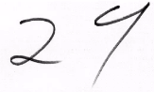
No Ambiguity in Data Interpretation
How to read this number
A) 29
B) 27
C) 24

Slide 14
N/A: Not Applicable
Empty spaces in GMP document shall be filled with N/A.
Sr. No. | Employee Name | Employee No. | Sign | Remarks
1 | Pravin Barpete | 110001 | xxxx | N/A
2 | Abhijit Patel | 111002 | yyyy | N/A
N/A
DCBA
05/05/2025

Slide 15
Ditto Mark (----”----)
Ditto Mark – Never use Ditto Mark for repeating the entries.
Sr. No. | Temp | Date | Time | Sign | Remarks
1 | 22.5 | 02/07/2025 | 09:35 | XYZ
2 | 24.5 | ---”--- | 10:35 | XYZ
3 | 24.0 | ---”--- | 11:35 | XYZ

Slide 16
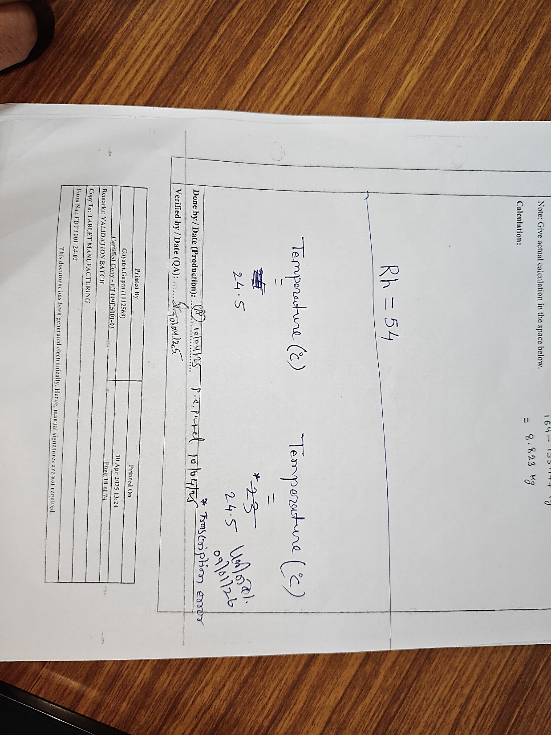
Overwrite
Invalid Entry:
Valid Entry:
.
Who corrected
When corrected
Reason for correction
Traces of original entry
Who corrected
When corrected
Reason for correction
Traces of original entry
Not Available
Available

Slide 17



Error Correction
Correction of any entry
Original entry must be readable.
Should provide information on the date of the change, and the person making the change.
If a mistake is made, do not correct it with whitener or anything else that would hide or erase the original entry.
Erasers and overwriting are not acceptable.

Slide 18
Thank You
Any Questions?

